Slide 1
The New OpenModelica Instance-Based API
Adeel Asghar Per Östlund
Santa Anna IT Research Institute

Slide 2
OMEdit and instance API
JSON representation of the model
Both the old and the new API are supported
Start OMEdit from the terminal with argument --NAPI=true to enable new API.

Slide 3
Problems
Conditional connectors
Enable/disable parameters
Visibility of graphical primitives based on boolean parameter
DynamicSelect
Choices

Slide 4
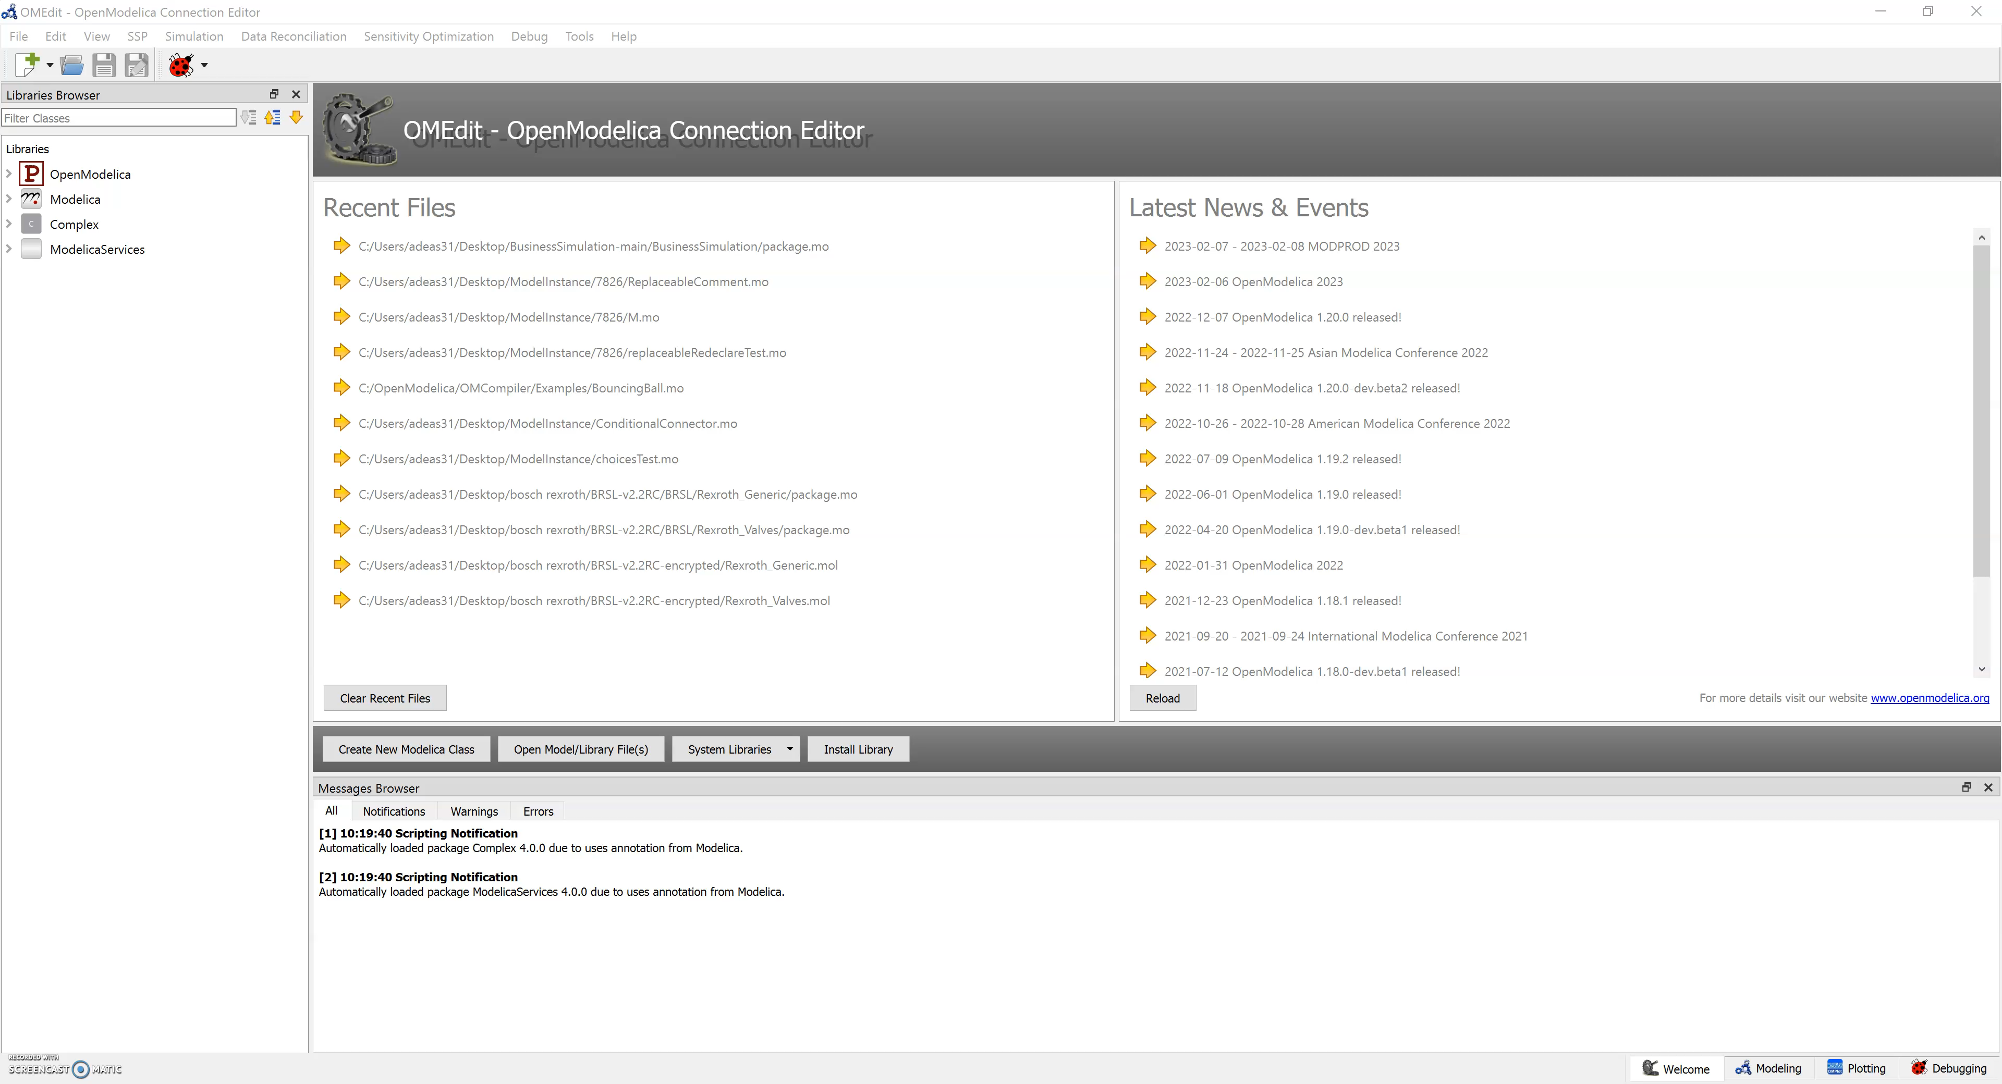
Conditional Connectors

Slide 5

Enable/disable parameters

Slide 6
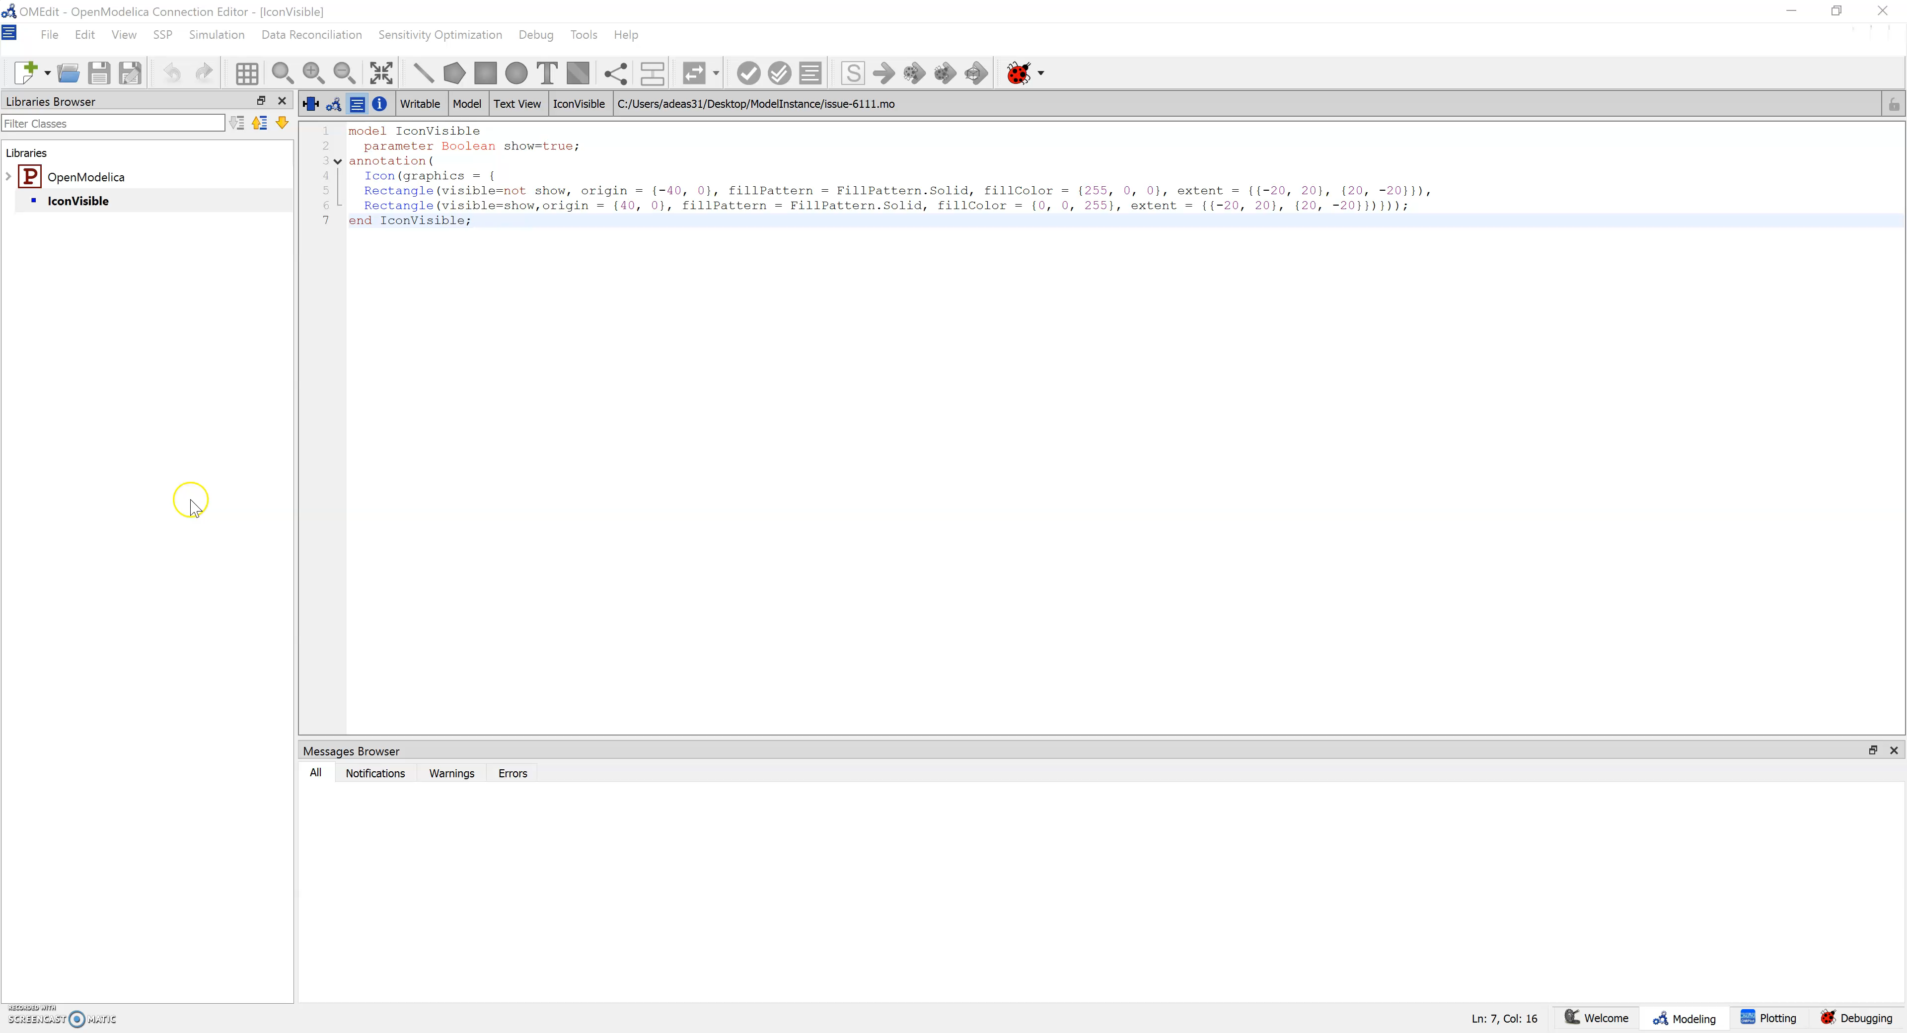
Visibility of graphical primitives based on boolean parameter

Slide 7
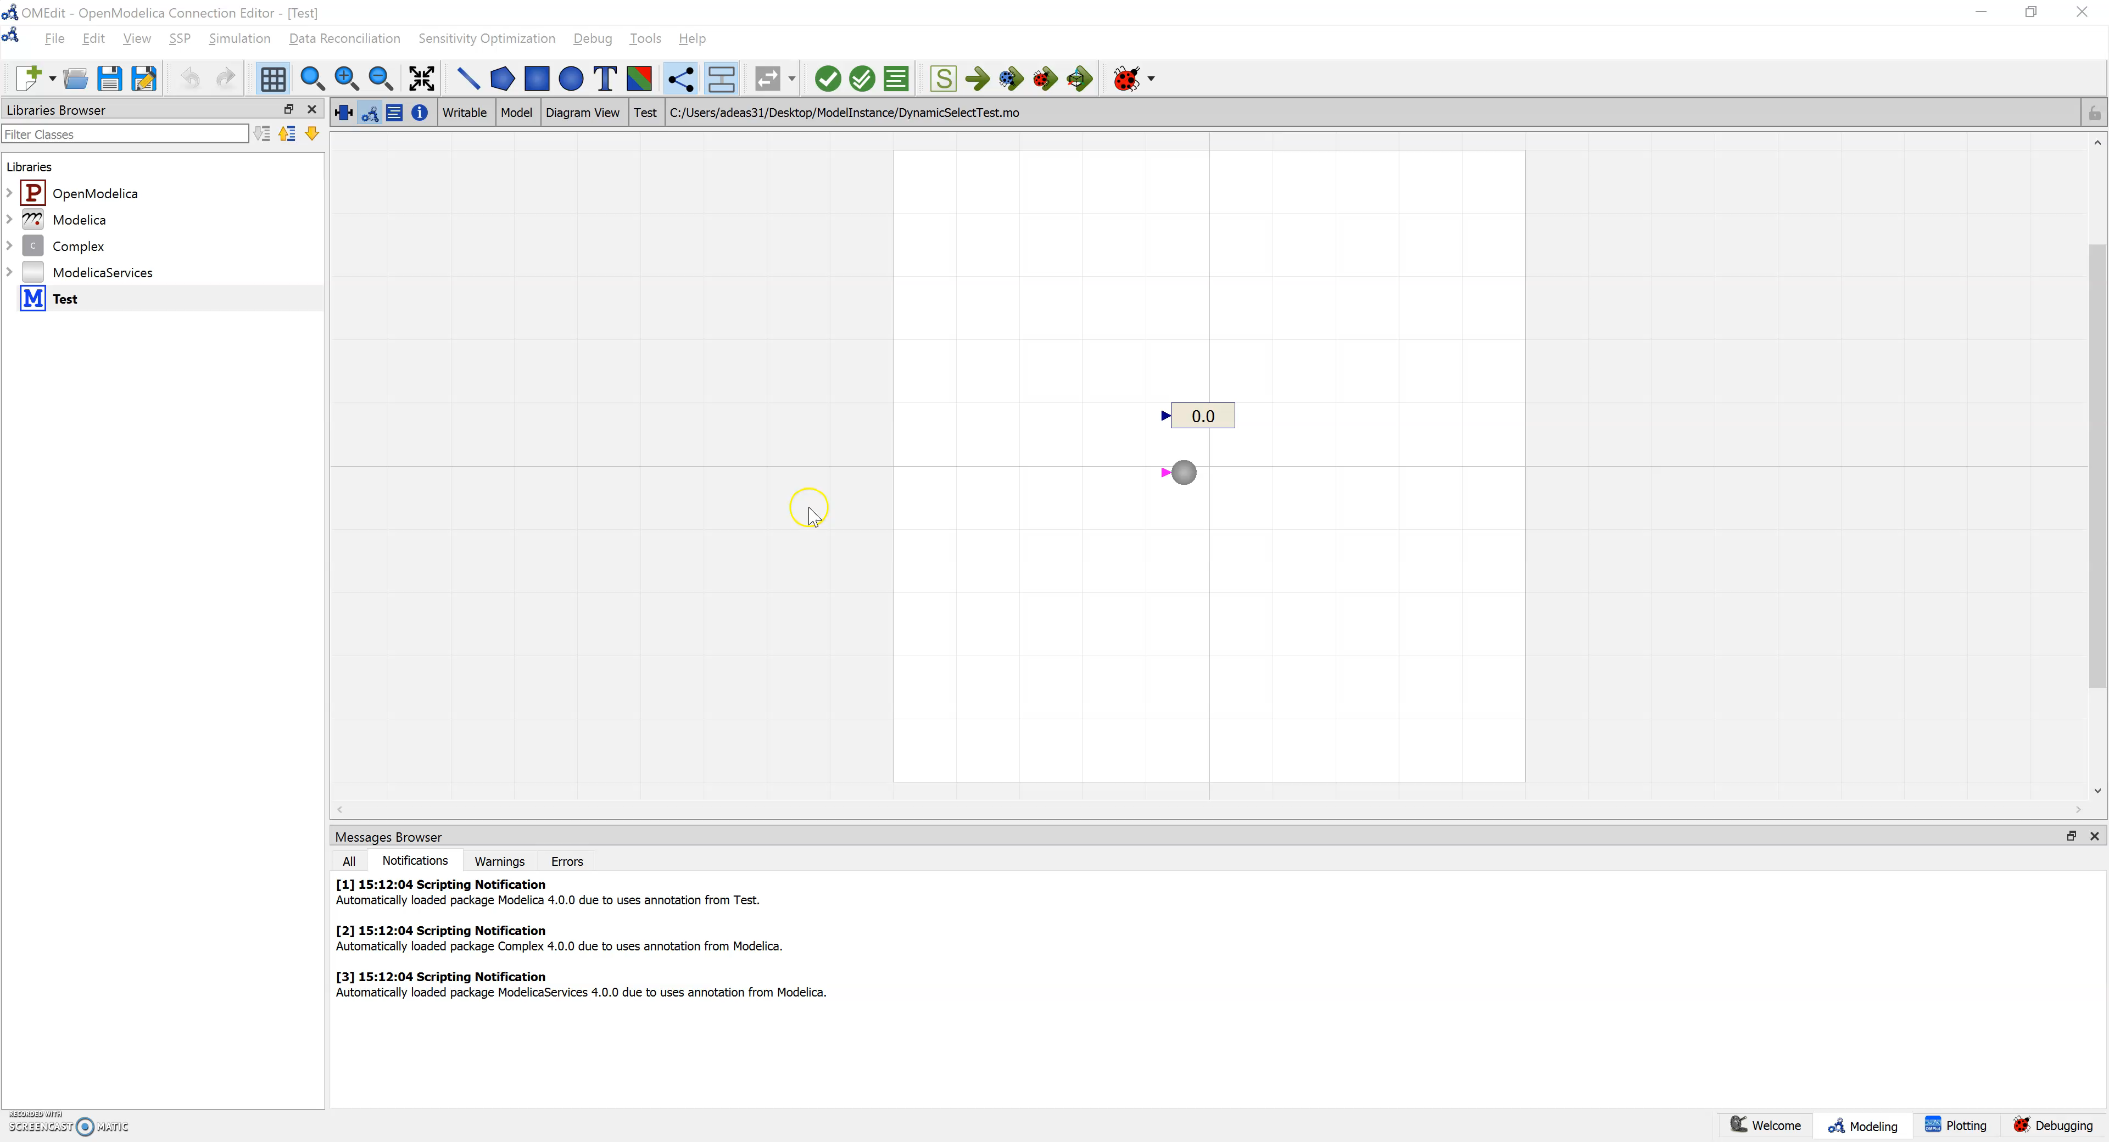
DynamicSelect

Slide 8
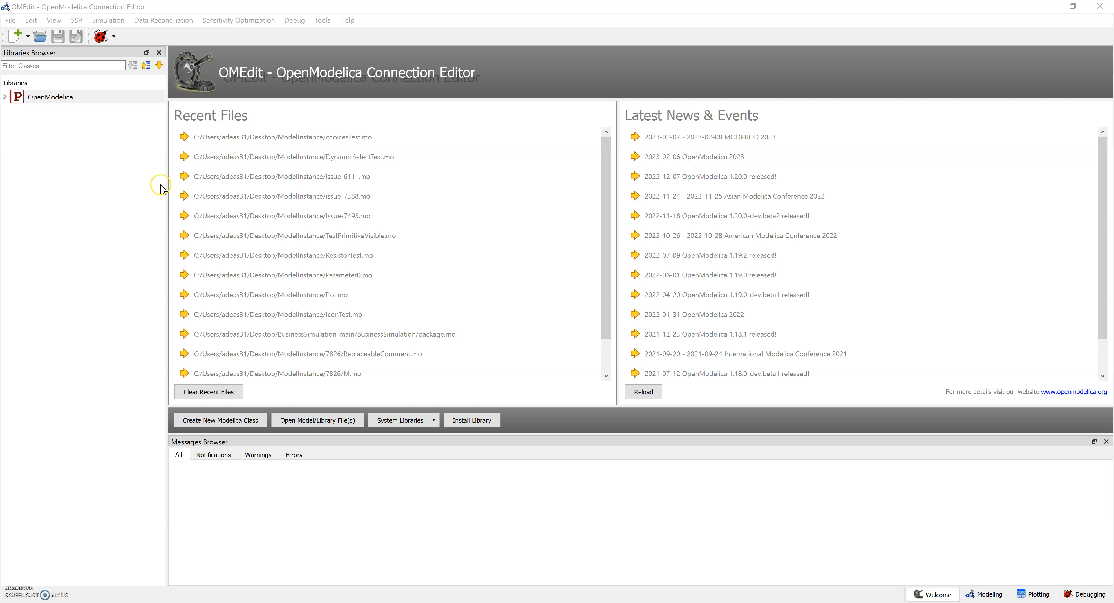
Choices

Slide 9
Ongoing Work
Better support for replacable classes and components
Modifiers of redeclared classes
Incomplete models
Instance API stability and performance

